Slide 1
Google Maps: Unsupervised Learning on Restaurants in PA
Zimeng Liu 4/6/2023

Slide 2
4 Cities
Carlisle
Harrisburg
Pittsburgh
Philadelphia

Slide 3
Variables of Restaurants
Name
01
Rating
02
# of Ratings
03
Category
Address
04
05

Slide 4
Information about Each City

Slide 5
Results
* minimum number of rating = 500 & category ≠ Fast Food
Carlisle
118
4.2
529
Middlesex Diner (3000)
Pizza (14)
37
4.7 Hamilton Restaurant Redd's Smokehouse BBQ Seve-N-Dots
Pittsburgh
191
4.4
777
Primanti Bros. Restaurant (5900)
Italian (14)
88
4.8 Arepittas
Harrisburg
160
4.3
453
Fiesta Mexico (3100)
Mexican (13)
48
4.8 Alvaro Bread & Pastry Shoppe
Philadelphia
181
4.4
791
Fogo de Chão Brazilian Steakhouse (5000)
Italian (21)
85
4.9 Cilantro Mediterranean Cuisine
# of Restaurants
Mean of Rating
Mean of Rating Number
Restaurant Max #
Dominant Category
# of Restaurants*
Highest Rating*

Slide 6
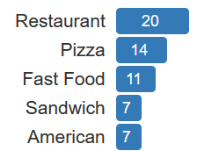
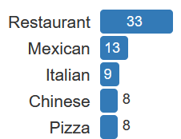
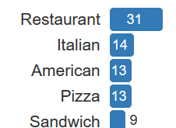
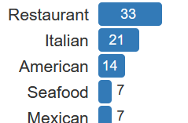
Category
Carlisle
Harrisburg
Pittsburgh
Philadelphia

Slide 7
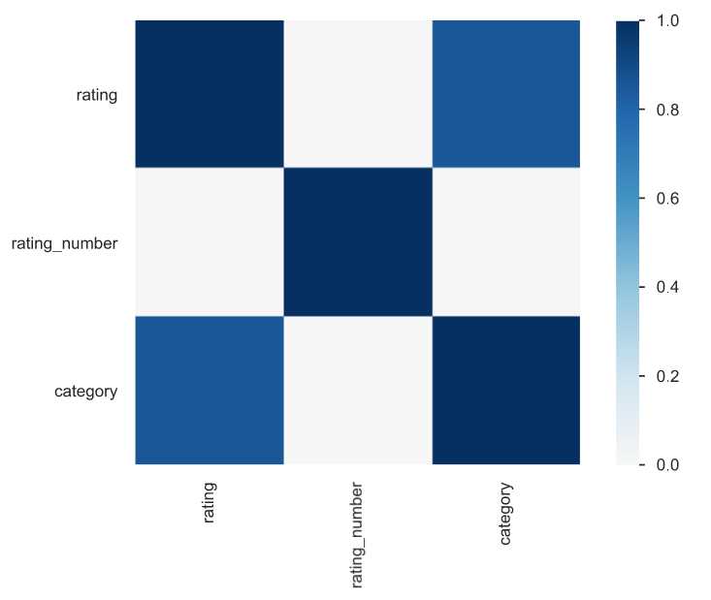
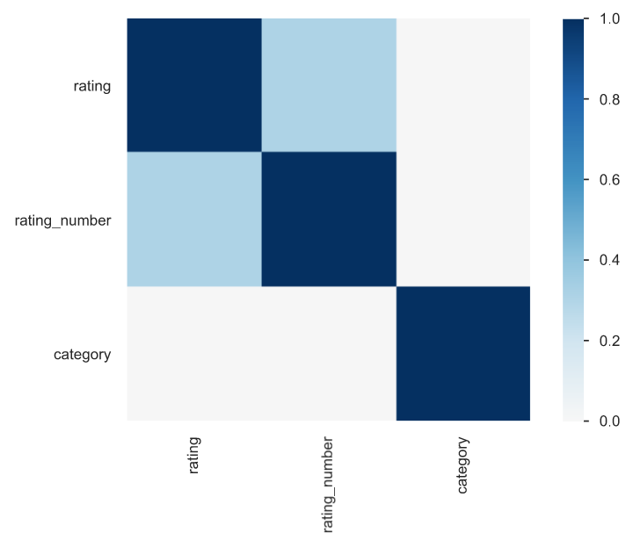
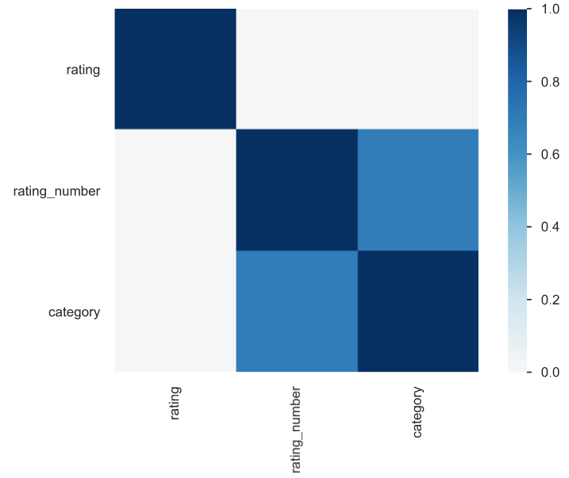
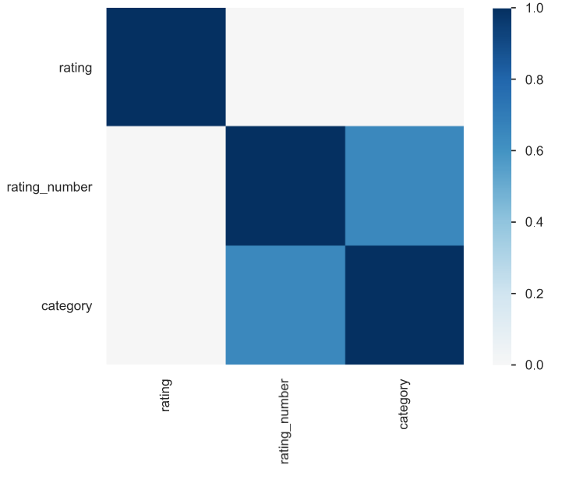
Correlations
Carlisle
Harrisburg
Pittsburgh
Philadelphia

Slide 8
Compare & Contrast
4 Cities

Slide 9
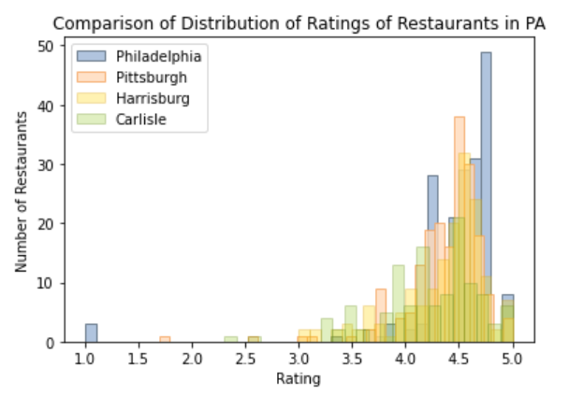
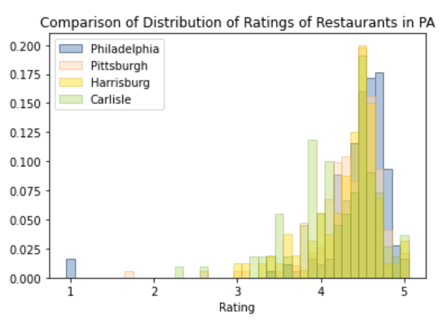
RESTAURANT

Slide 10
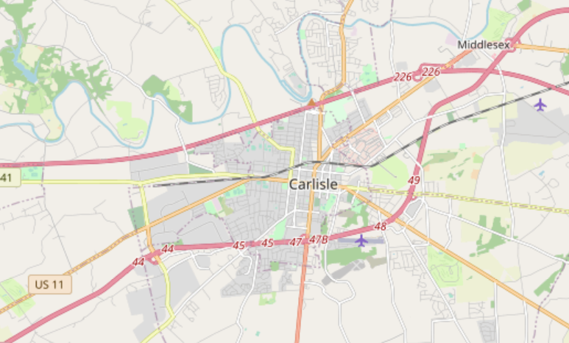
Next Step
Google Maps

Slide 11
Google Map
Thank you for listening!
Restaurants

